Slide 1

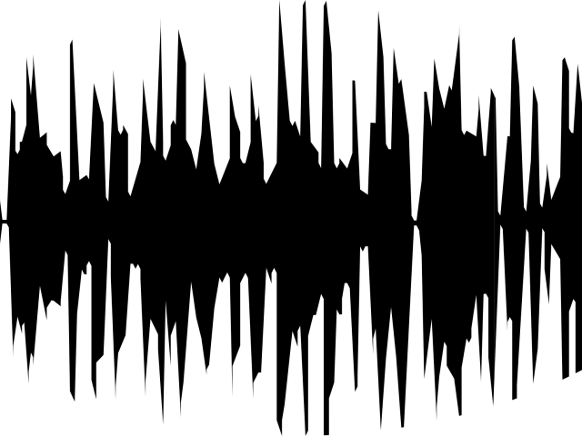
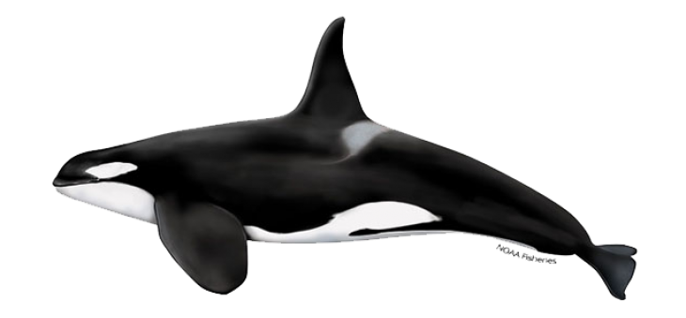


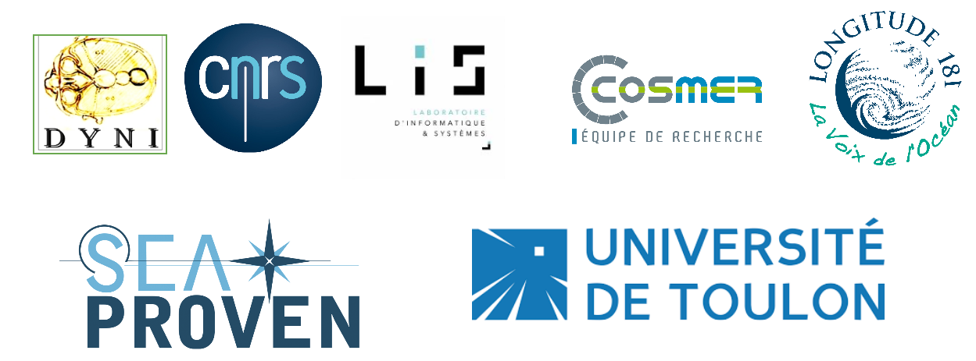


ORCA’S
PASSIVE ACOUSTIC in DYNI
Hervé Glotin, Marion Poupard glotin@univ-tln.fr
CNRS LIS DYNI, SMIoT, Univ Toulon, SABIOD MADICS

Slide 2
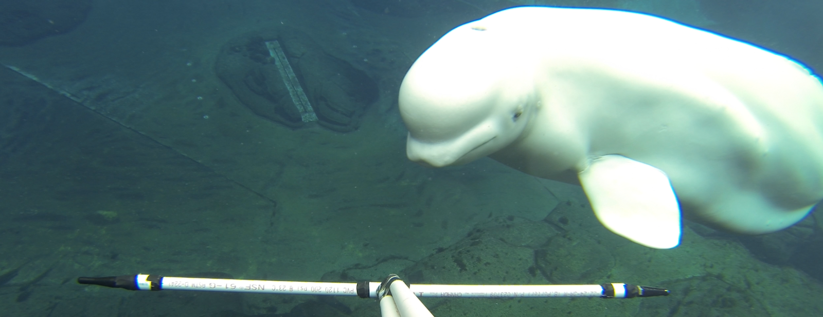
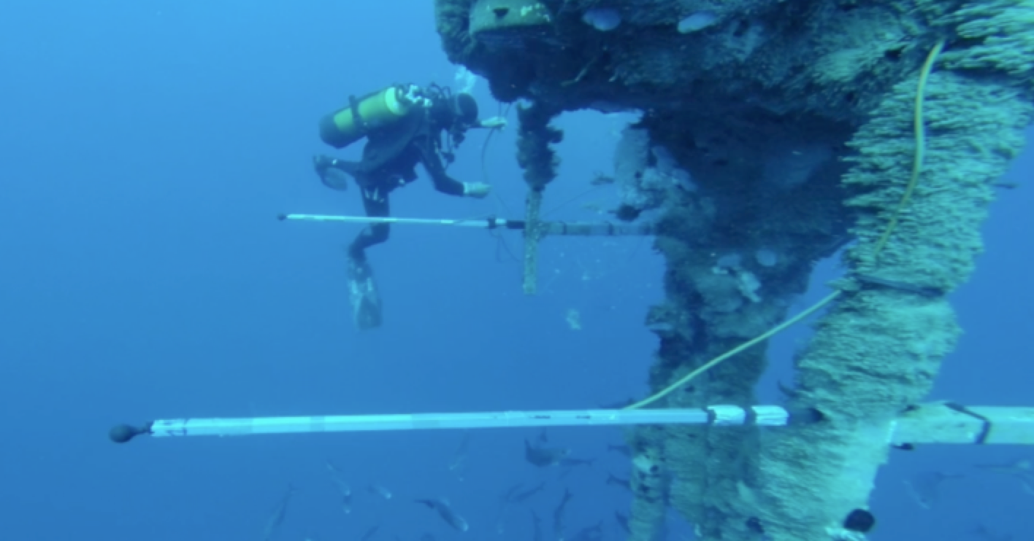
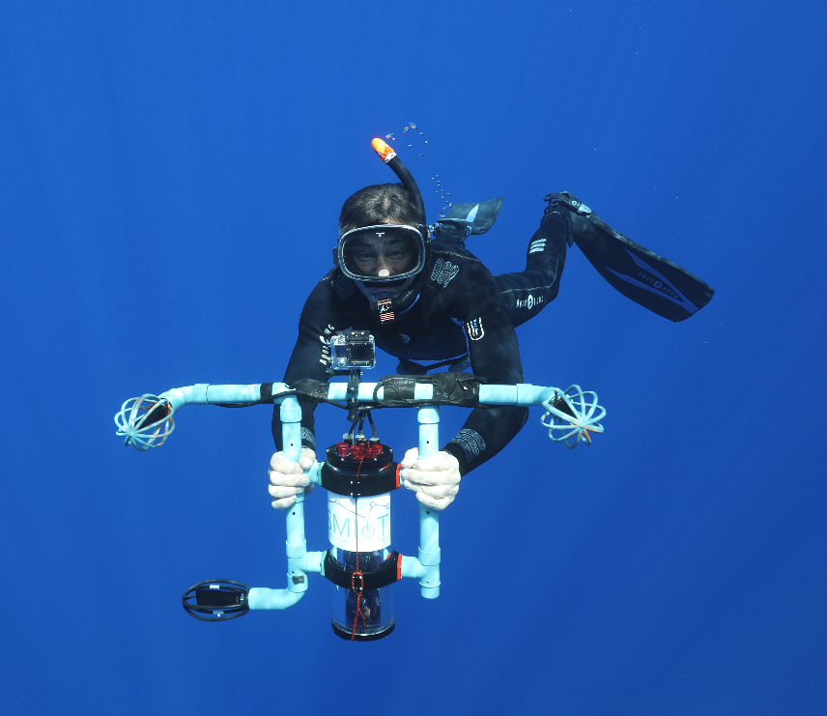
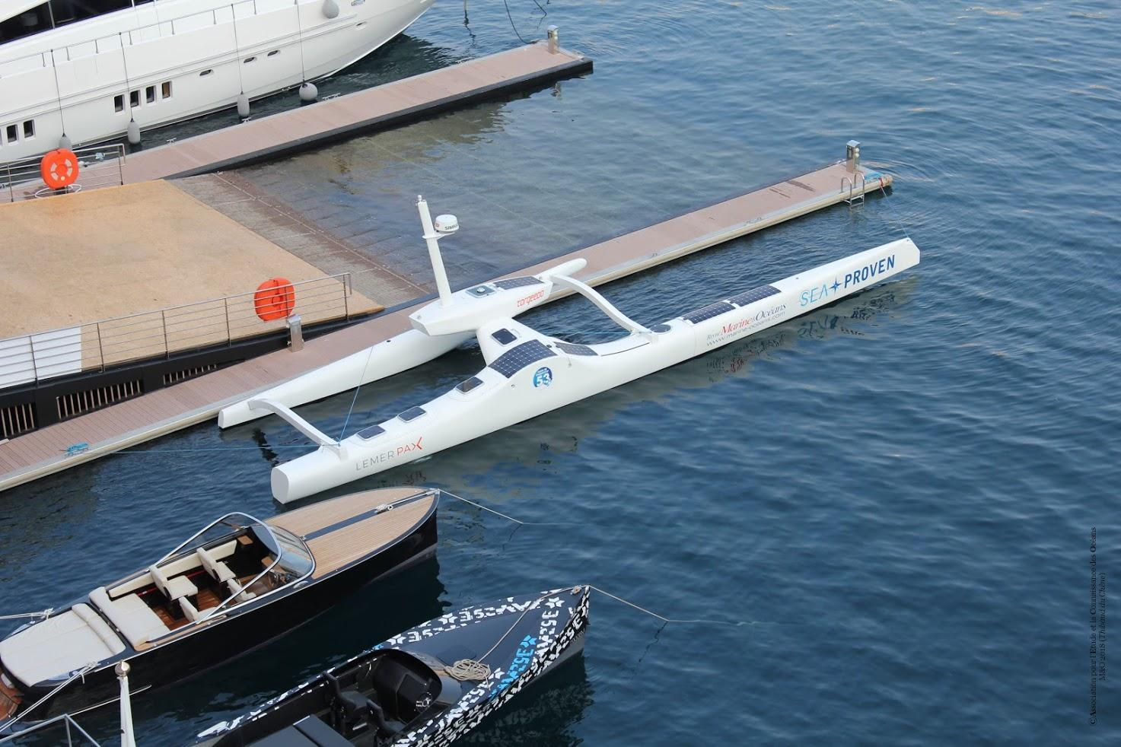
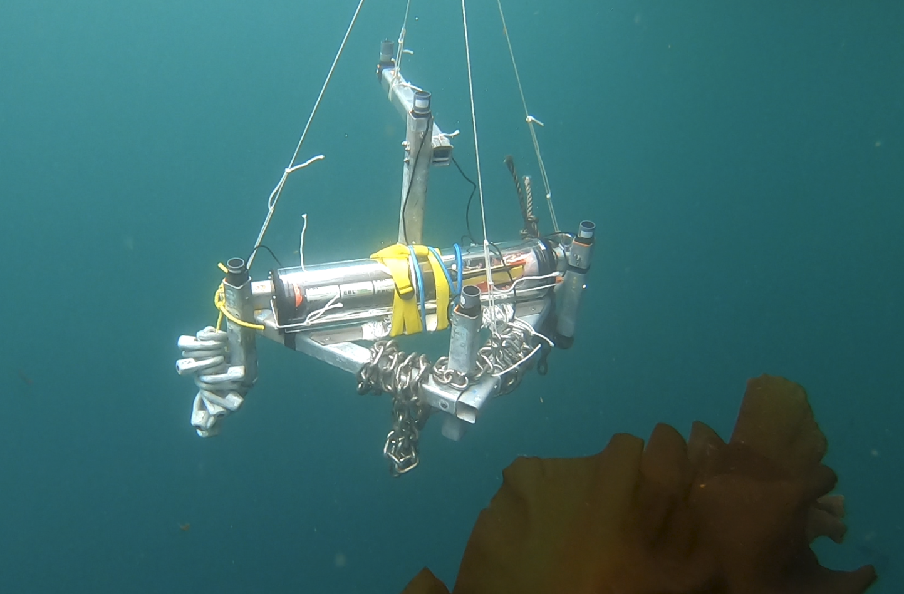
The team DYNI
We are research group of the Laboratoire d’Informatique & Systemes (LIS) - UMR 7020 CNRS hosted at the Université de Toulon (UTLN), France. Our aim is develop and innovate in methods of machine learning, signal processing and data analysis in order to improve our knowledge and understanding in physical and natural systems.

Slide 3
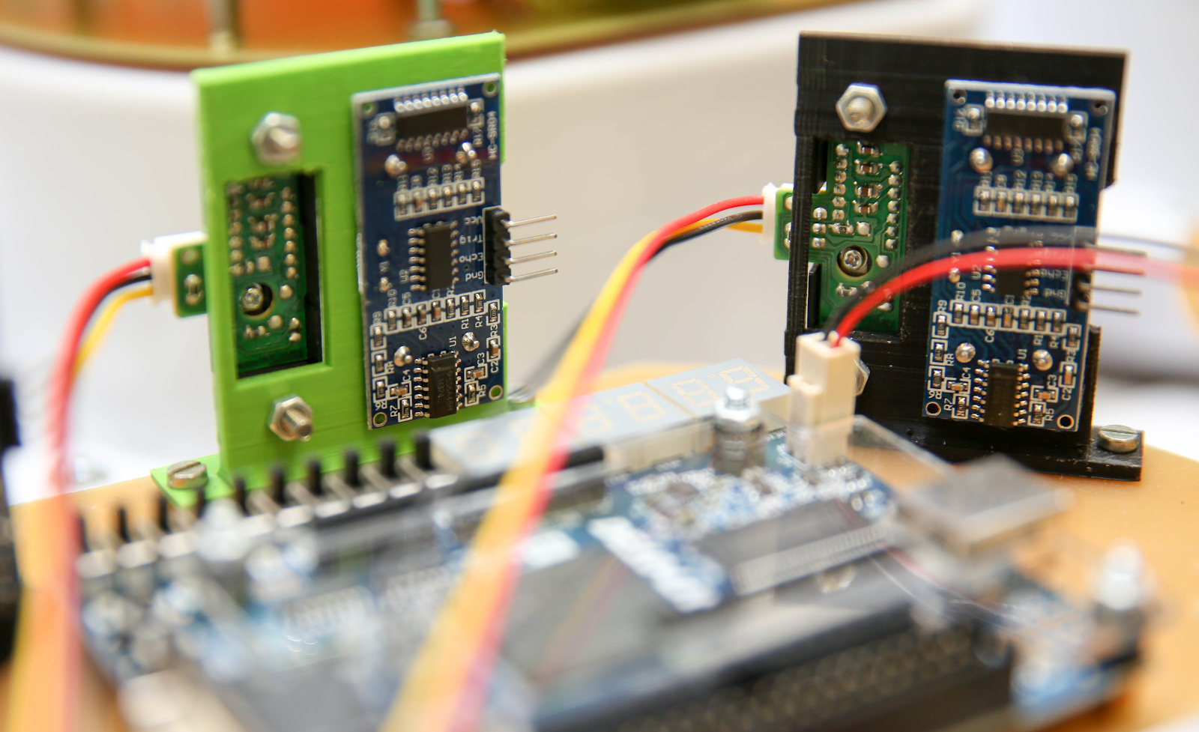
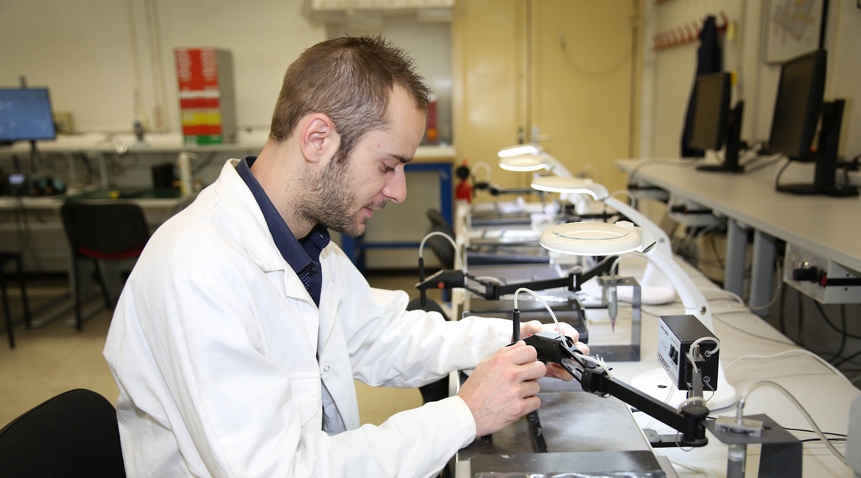
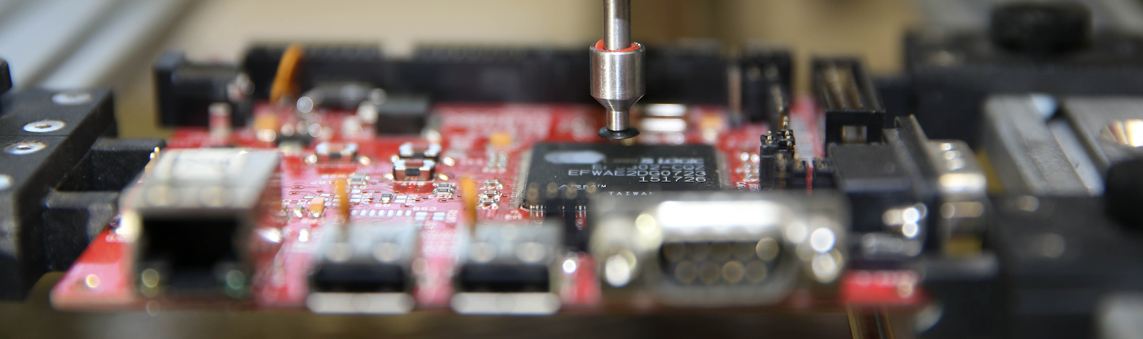
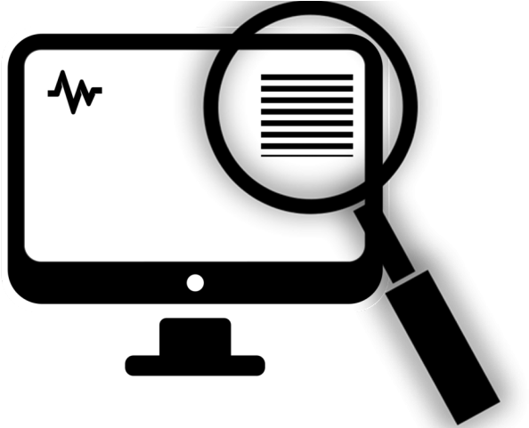
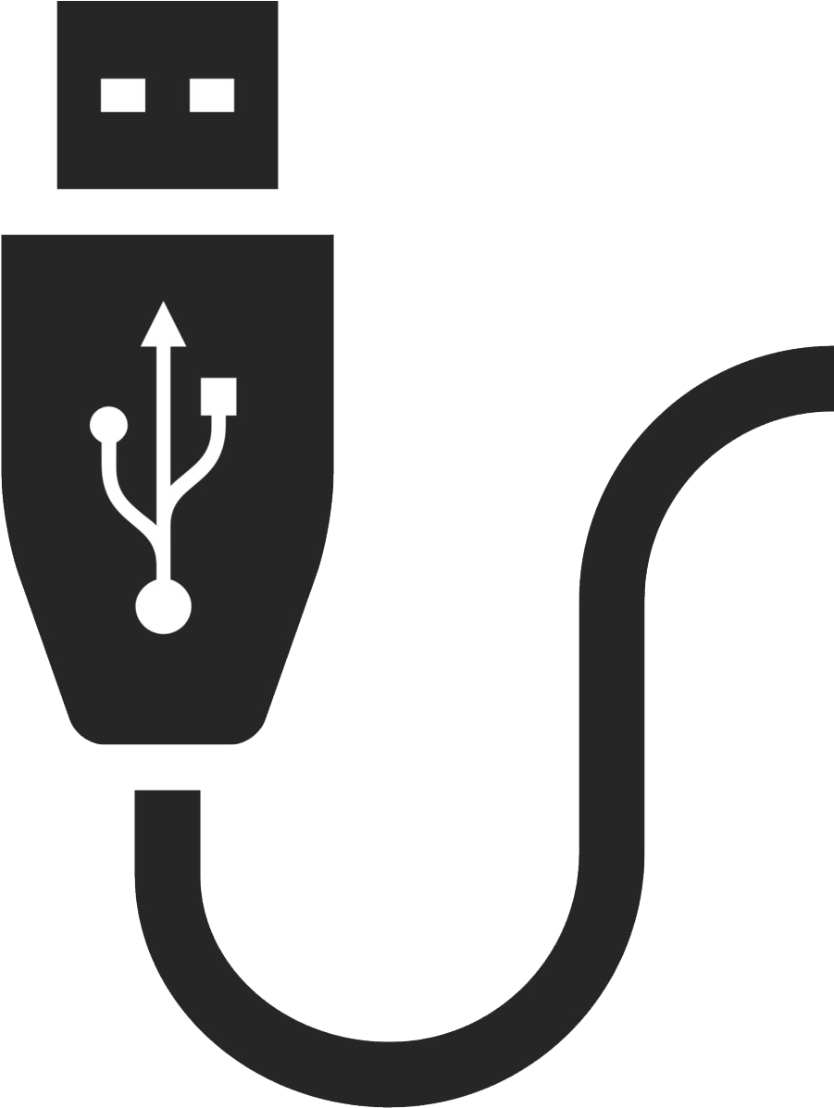
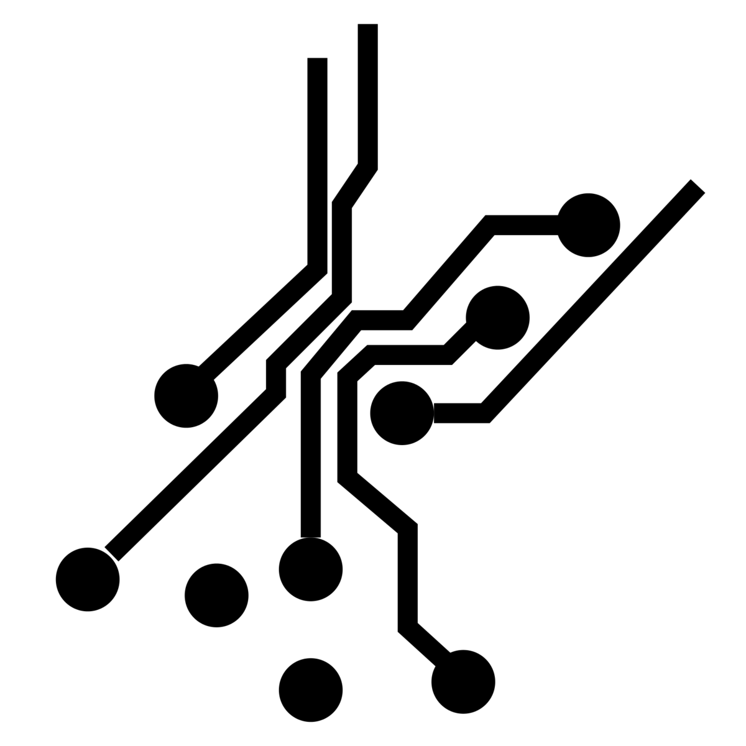

SMIoT: Scientific Microsystems for the Internet of Things
Design of electronic hardware (conception et routage des PCB), front-end, RF.
Assembly and testing of electronic prototypes
Industrialization of connected objects
Design, Test and Construction of the
HIGH BLUE MONO system

Slide 4
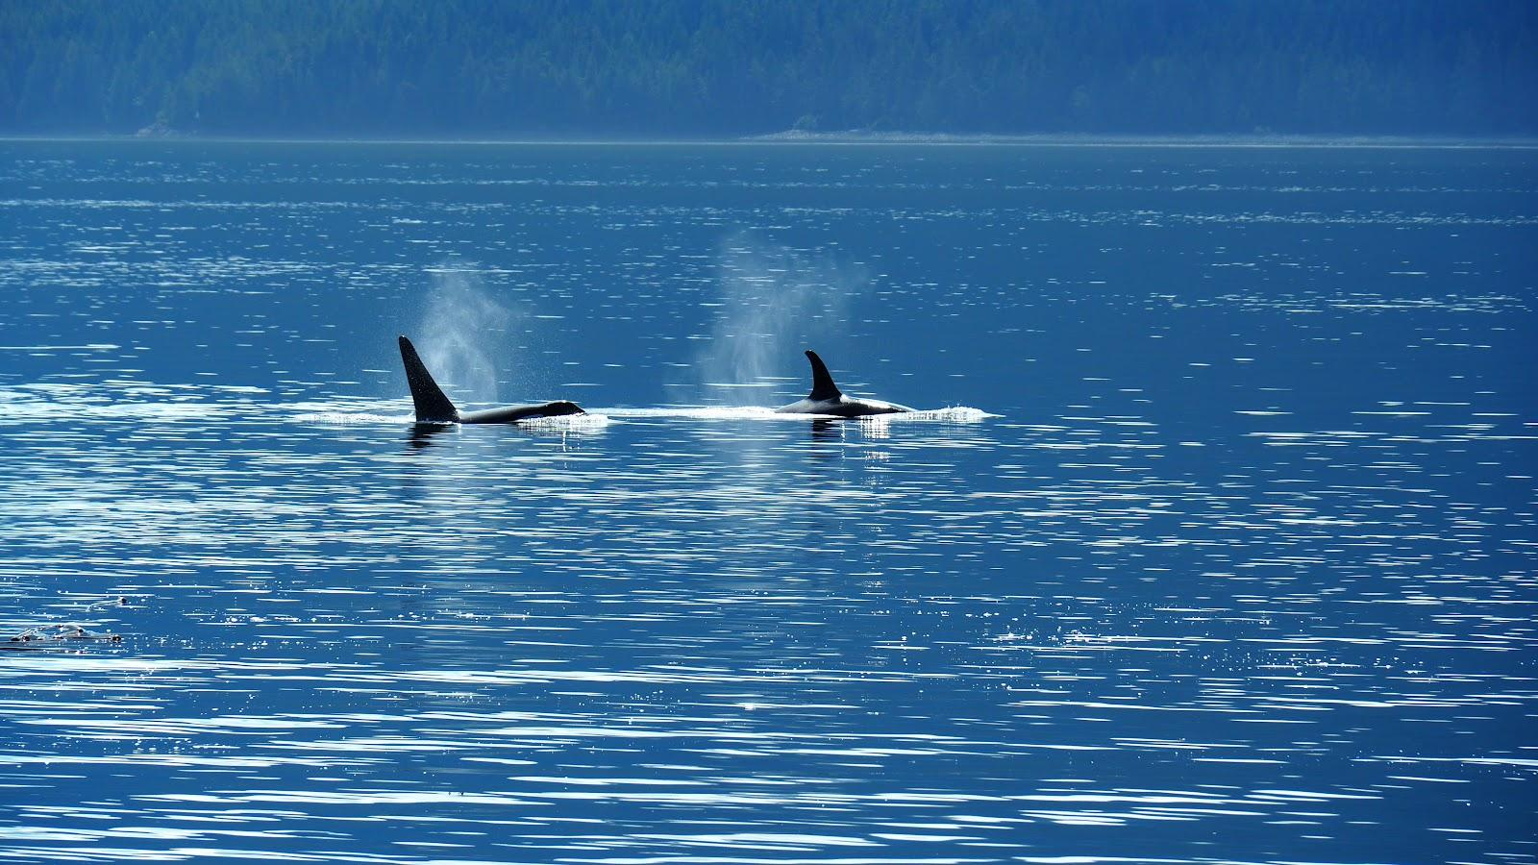
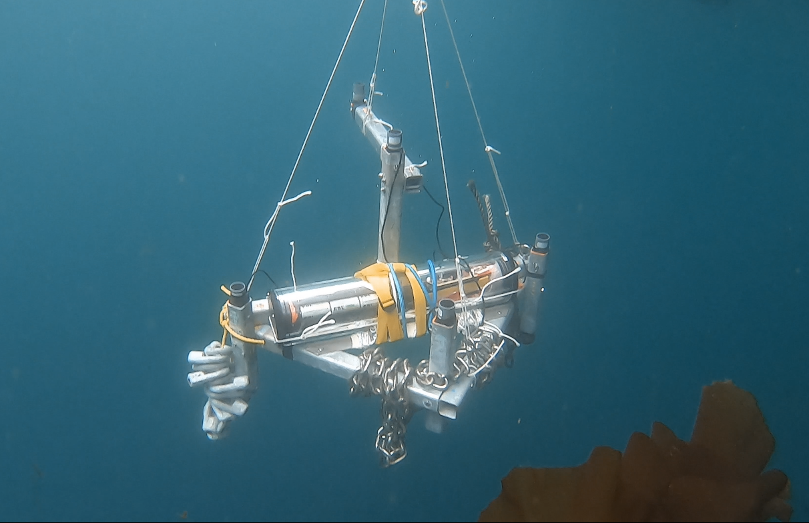
Our recent and futur projects
Detection of orcas over 3 years in Orcalab
Projects in Norway
© Marion Poupard
© Marion Poupard
© Marion Poupard

Slide 5

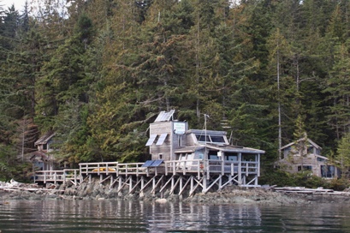
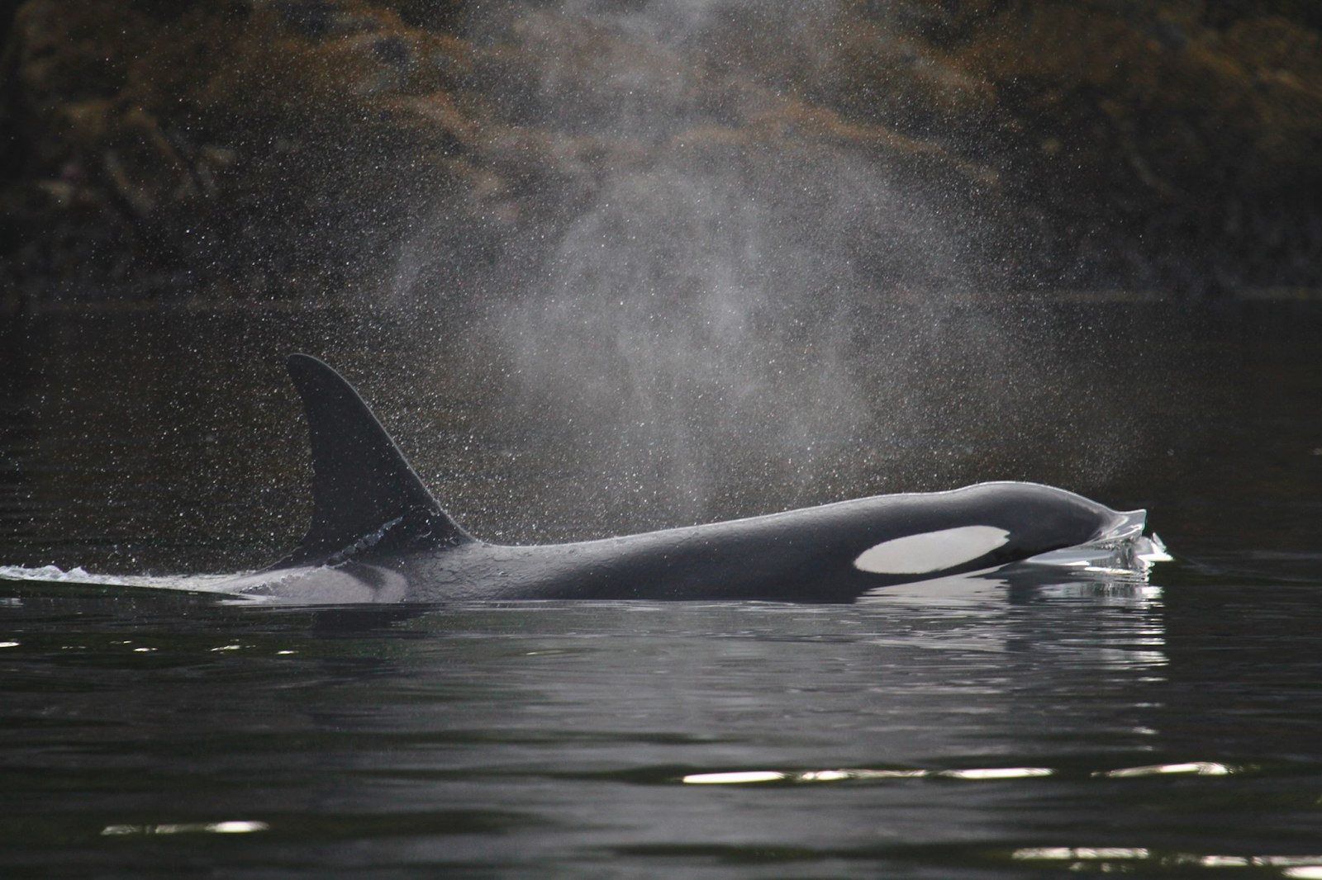
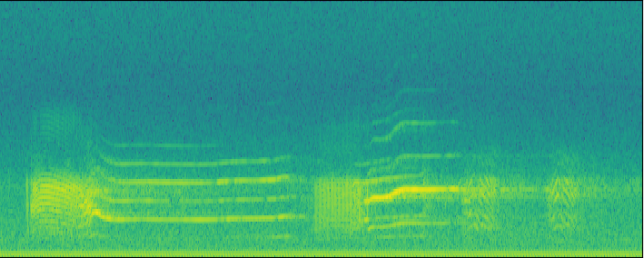
Deep Learning for Ethoacoustics of Orcas
on three years pentaphonic continuous recording at Orcalab revealing tide, moon, and diel effects
Introduction | Material | Data analysis | Results | Discussion | Conclusion
Notes:
Hello, today I’m going to talk about a new study call deep learnig fo ethoacoutsics of orcas on three …

Slide 6
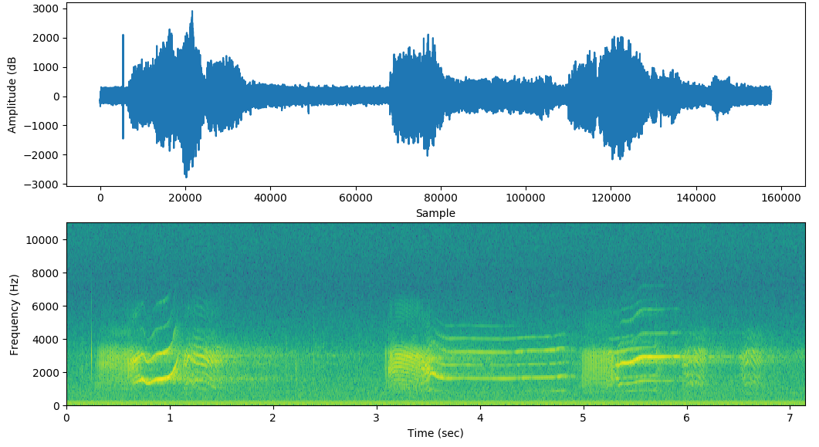
Introduction
Orca (Orcinus Orca) top predator of the marine food chain.
The Northern resident killer whale community [1]
Pods dialect: repertoire of 7-17 discrete calls.
How describe the orca communication?
Automatically detect orca calls emitted throughout 3 years of continuous recording from 2015 to 2017
Influence of environmental data on orca vocalization ?
Fig 1: 7 seconds of vocalizations
Introduction | Material | Data analysis | Results | Discussion | Conclusion
Notes:
The species for this study is Orcas Orcinus Orca. This cetacean live in every water of the world, and they are the top predator of the marine food chain.
This study focuse on the Northern resident killer whale community,
This community is composed of several “pods” composed of matriline
Some pods visit the area surrounding Hanson Island(Canada, north of Vancouver) due to the concentration of salmon [3].
Th eNorthern Resident Killer Whale community is composed of more than 300 individuals (in 2018) organized into several pod, each of pods possess their own dialect (a repertoire of 10 discret call).
For twenty years, Orcalab study orcas in Hanson Island and they developpeda unique hydrophone recordings stations.
This study focuse of the analyze of orcas communication in this area, and automaticcally detect orcas calls emmited during 3 years.
And the ojective of this study is to show the influence of the environmental conditions on the orca vocalizations

Slide 7
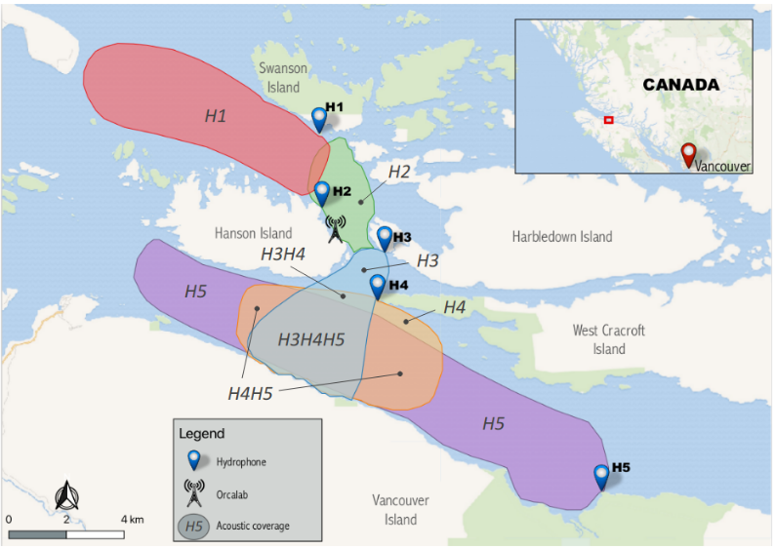
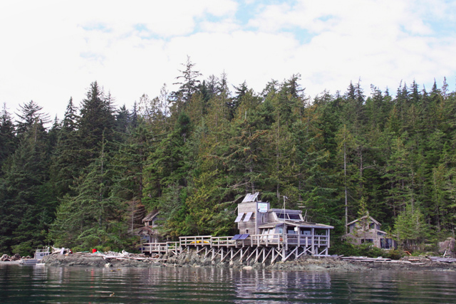
Material
Fig 3: Orcalab Station, Hanson Island, Canada
Fig 2: Map of the area and the listening range of the 5 hydrophones
Introduction | Material | Data analysis | Results | Discussion | Conclusion
Notes:
To help with solving this paradigm, in 2015 (two thousand fifteen) DYNI team have set up a continuous recording of all the hydrophones of this station.
The aim is to allow observations and modelling bioacoustic activities of orcas.
On theses pictures you can see the map of this recordings,
Since twho thousand fifteen

Slide 8
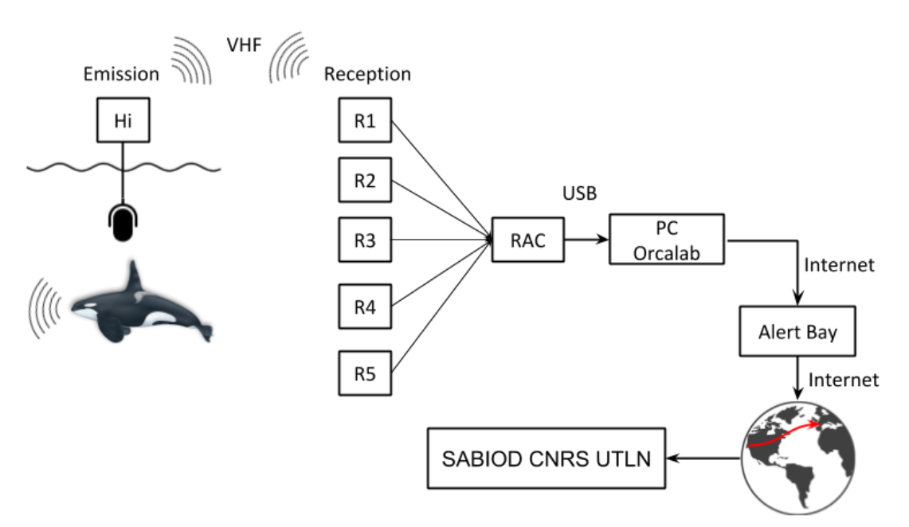
The hydrophones record the soundscape continuously.
Transmission of recordings to the Orcalab station in real time via VHF.
Then digitized to a Presonus analog-to-digital converter (ADC) and sent to a PC in Orcalab.
The recordings are then compacted in segments of 2 minutes including all 5 channels (.flac, 22050 Hz)
Each segment is then sent to DYNI Toulon University big data NAS (Network Attached Storage) .
In total, from July 2015 to 2017, around 50 TB of sound (about 14,500 h) was stored on our server.
Fig 4: Representation of the data acquisition, from recording until storage on SABIOD CNRS UTLN server
Introduction | Material | Data analysis | Results | Discussion | Conclusion
Notes:
The architecture of the global system is shown here.
The recordings are transmitted to the OrcaLab station in real time via very high frequency (VHF) radio. and then digitized o na Presonus analog-to-digital converter (ADC) and sent to a PC in Orcalab.
The recordings are then compacted in segments of 2 minutes including all 5 channels, using lossless flac compression, witha sampling rate of 22050 ( twenty-two thousand fifty) Hz
Each segment is then sent to DYNI Toulon University.
In total, from July two thousand fifteen to 2017, around 50 TB of sound was stored.

Slide 9
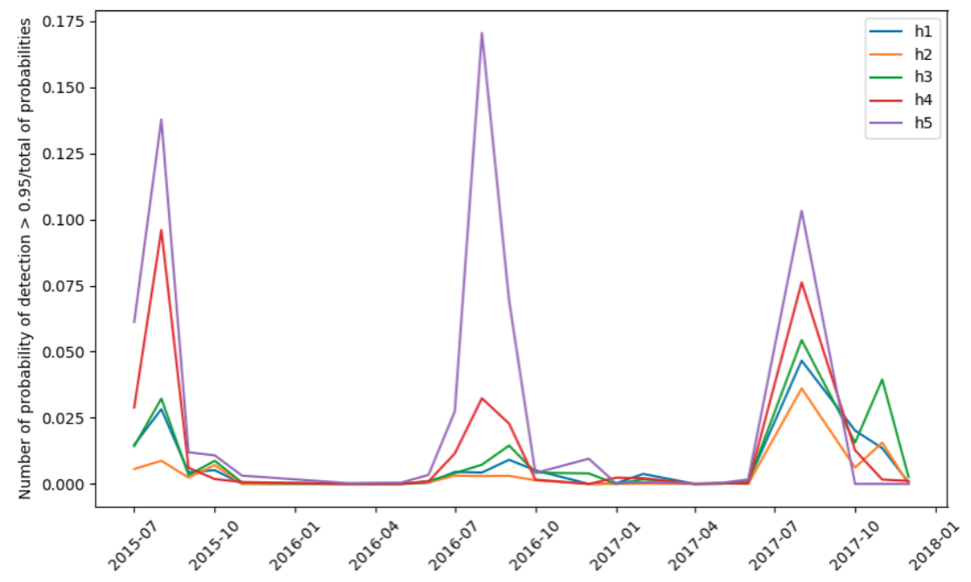
Large scale statistics
2 days of computation required for 2015-2017 data.
Orcas are present (acoustically) mostly during summer (June, July, August and September).
orcas are abundant in Johnstone Strait between July and October, when salmon migrate into it.
The second peak (October-December) may reflect the presence of Humpback whales.
Fig 6: Proportion of two-minutes recordings with detected orca calls per
month and hydrophone, from 2015 to 2017.
Introduction | Material | Data analysis | Results | Discussion | Conclusion
Notes:
Now We can see the global result of the model,
Here you can see the number of probability of detection superior to 0.9 divided by the total of probability for the 3 years of recordings.
listening to a few recordings,
I listened to some recordings, and they were well whales
we have indeed noticed humpback whale vocalizations

Slide 10
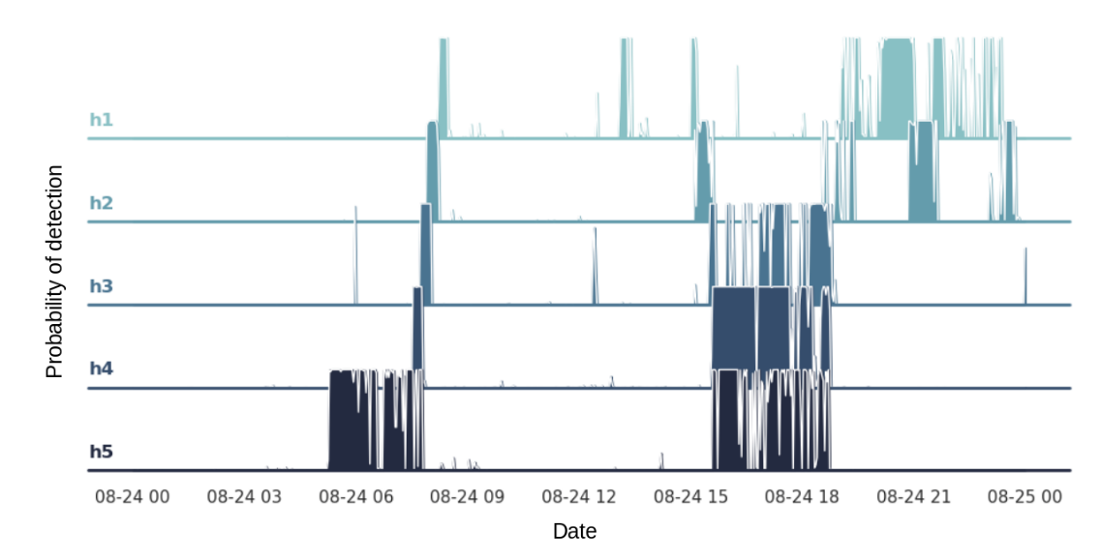
Trajectography
Estimation of the acoustic activity of orcas in the range of each hydrophone over time.
Example for August 24, 2017.
Fig 7: Example of the evolution of the probability of call detection for each hydrophone during one day (August 24, 2017). During the morning, a group of orcas comes from the east on H5, and is moving on H4, H3, H2 then on H1. Different round trips are made during the day.
Introduction | Material | Data analysis | Results | Discussion | Conclusion
Notes:
In order to get an idea of animal trajectories, one can estimate the acoustic activity of orcas in the range of each hydrophone over time.

Slide 11
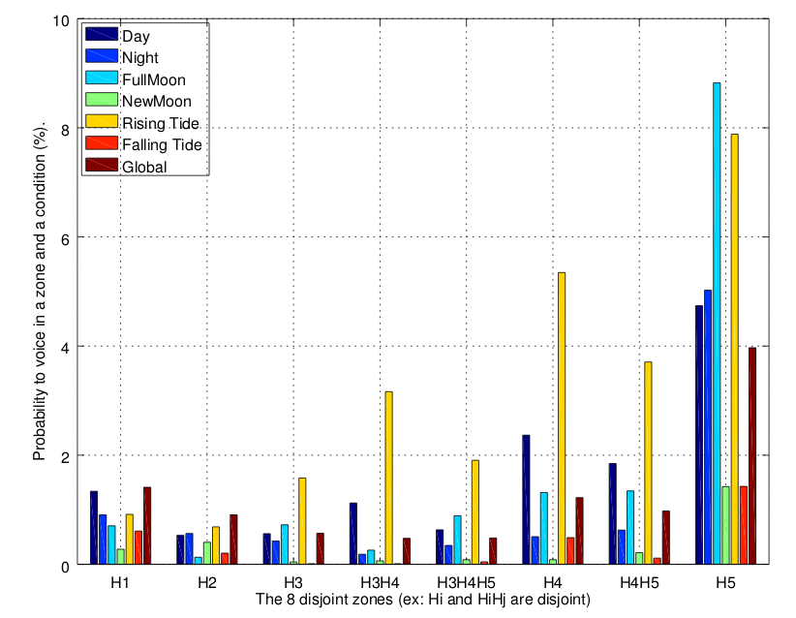
Voicing statistics
Analyze of the voicing activities according to:
Day time/Night time.
Full Moon time (from 4 days before to 4 days after a full moon), new Moon time .
Rising tide / falling tide.
Detect orca calls in each zone during a given time interval.
Global patterns of the orcas’ voicing activity in time and space variations in the voicing.
Activities of up to a factor of four between conditions and zones.
The biggest variation concerns the influence of tide and moon in zone H5.
Fig 12: Probability of voicing of orca in a zone during a given condition.’Global’ refers to no specific condition.
Introduction | Material | Data analysis | Results | Discussion | Conclusion
Notes:
More precisely, we computed the probabilities to detect orca
calls in each zone during a given time interval, this is show in this figure.
This result shows the global patterns of the orcas’ voicing activity in time and space, based on the continuous 3 years of recordings. It reveals variations in the voicing activities of up to a factor of four between conditions and zones. The biggest variation concerns the influence of tide and moon in zone H5. In fact, this area is subject to strong currents during tidal hours. The Johnstone Strait is relatively deep (450 m), so the trophic chain can change according to the moon phase [16] and influence the orca acoustic activities

Slide 12
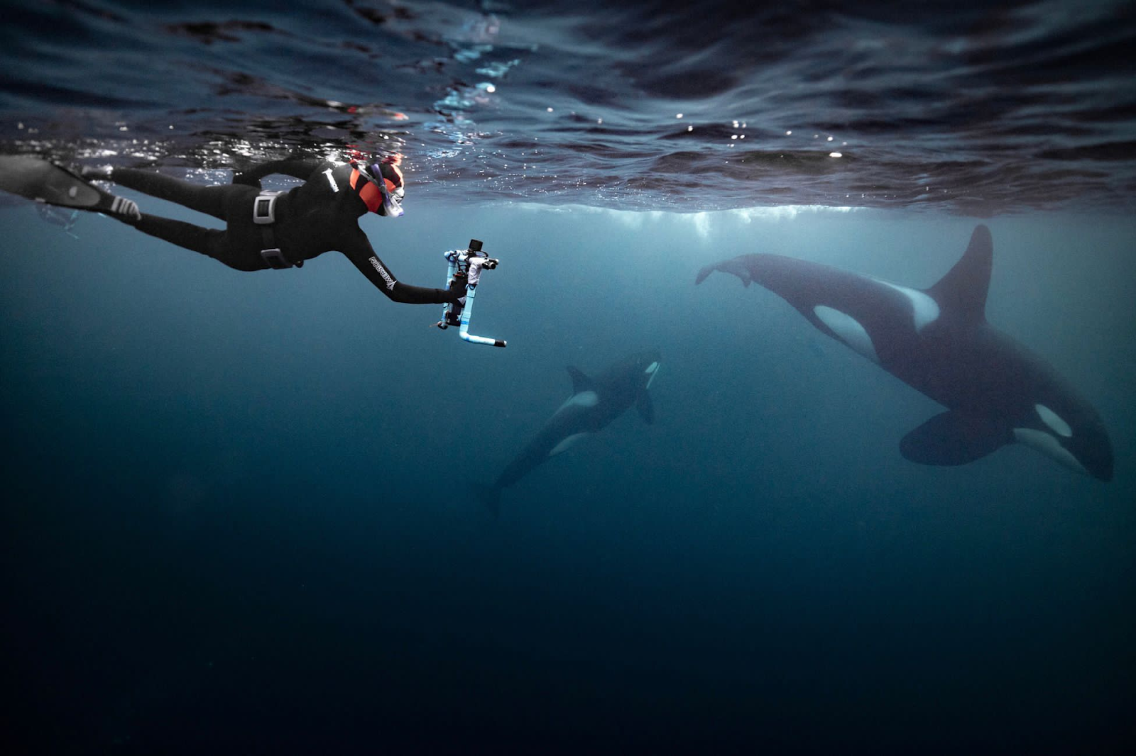
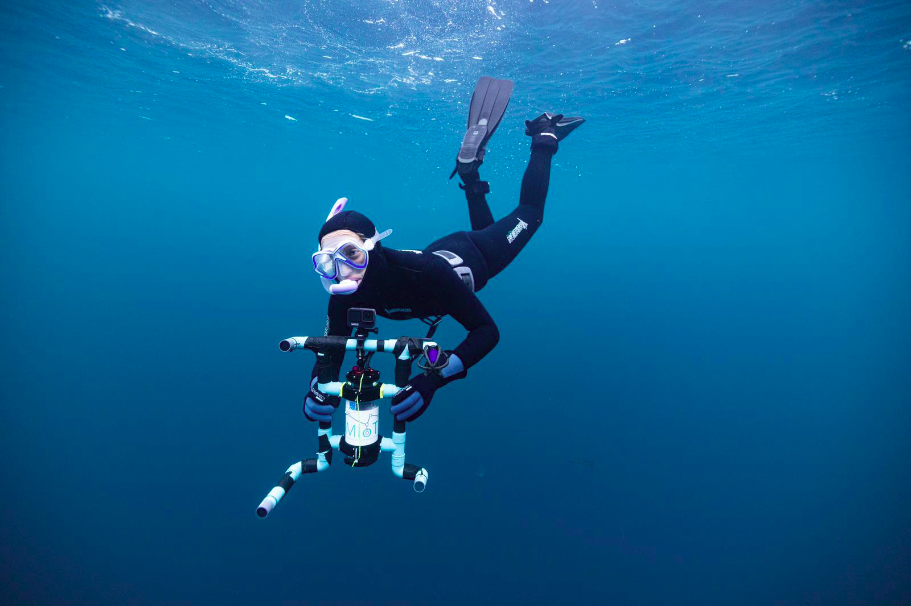
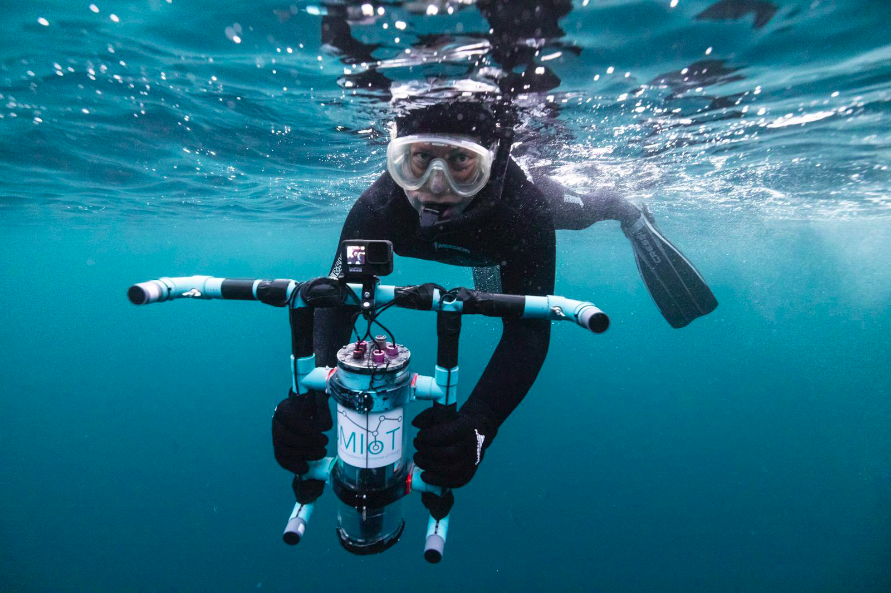
Project 1 in Norway: 2 mobile acoustic antennas
2 acoustic antennas with 5 hydrophones
Objectives : understand how orcas communicate during hunting/travelling periods
Associate calls/clicks to an individual
What are the interactions with humpback whales?
© Granzotto
© Granzotto
© Granzotto

Slide 13
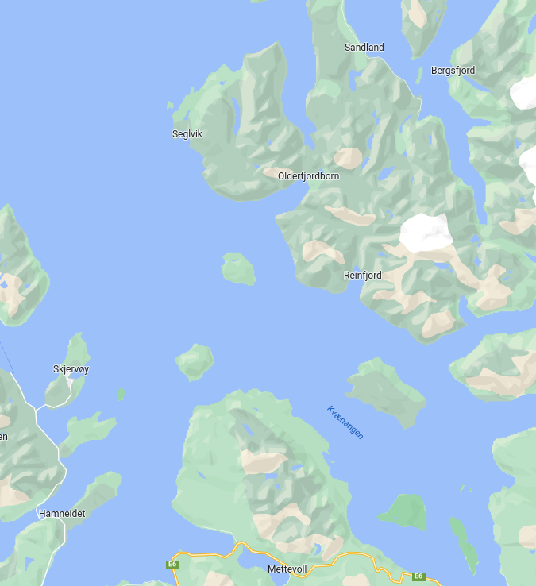
Project 2 in Norway: 2 static acoustic antennas
The hydrophones record the soundscape continuously for 3 months.
Analyze of the voicing activities H24 of rorqual, humpback, orcas and others (purposis, pilot whales…).
How cetaceans enter the fjord ? How long they stay in ?
Variation of vocal activities between night versus day time ?
Can we built a catalogue of the calls ?
Influence of environmental data on cetaceans vocalization ?
Monitoring of the antropophony (fishers…) during months / years,
and climate changes.
B

Slide 14
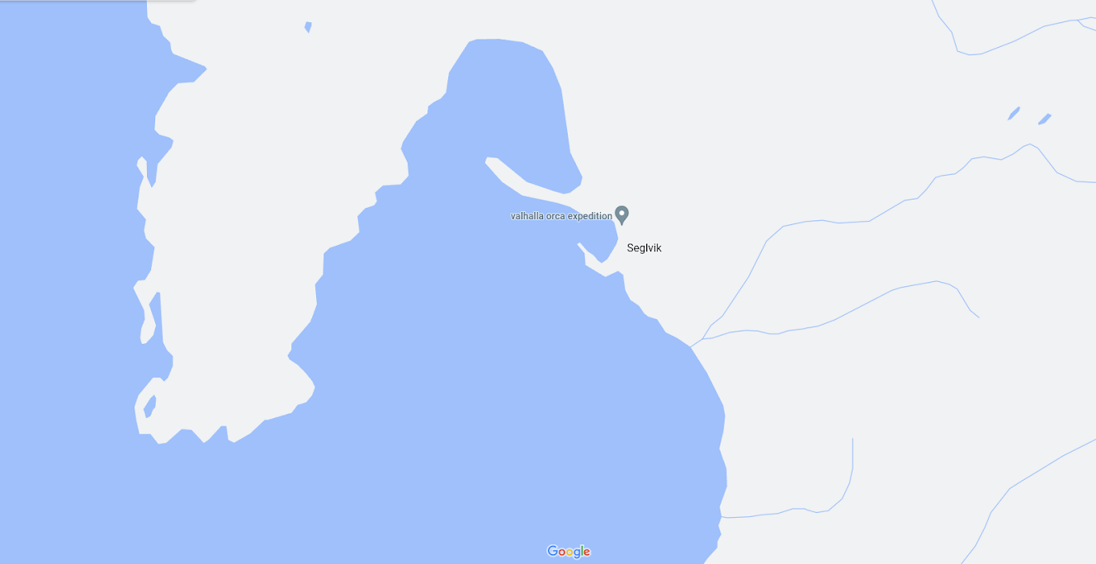
You can experience and listen Valhallab real time recordings from Whalehouse

Slide 15
Thanks for your attention !

